Slide 1

Relational Databases
ERD Examples

Slide 2
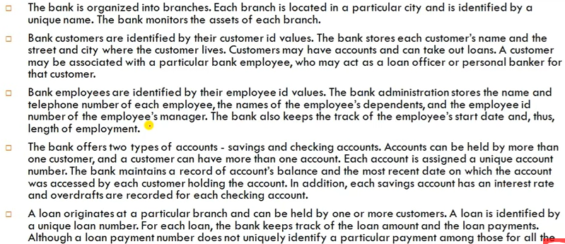
Requirements for a bank database

Slide 3
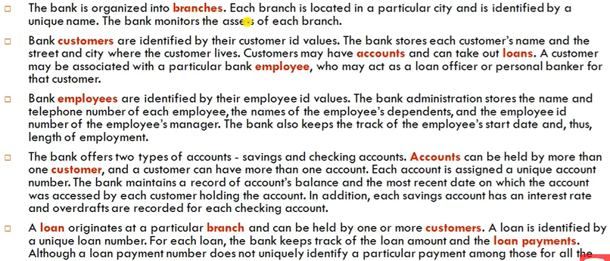
1.Identifying the ENTITIES

Slide 4
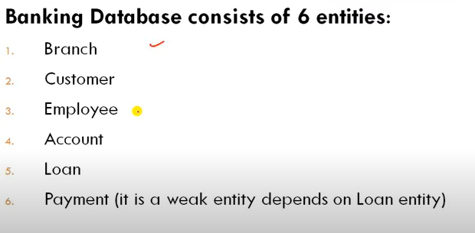
1.Identifying the ENTITIES

Slide 5
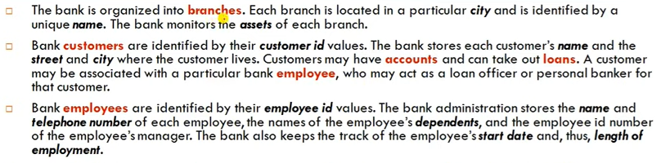


2. Identifying the Attributes

Slide 6
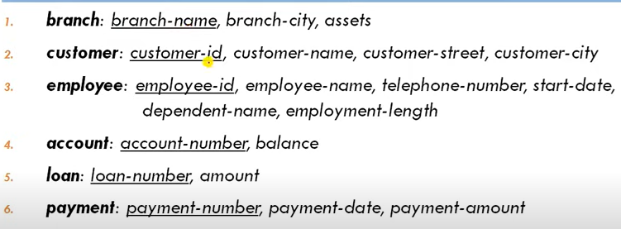
2. Identifying the Attributes

Slide 7
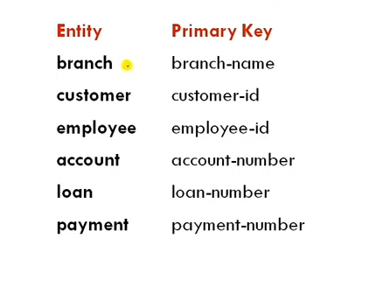
3.Identifying the Primary Keys

Slide 8
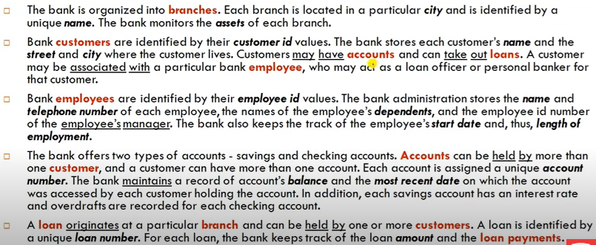
Identifying the Relations

Slide 9
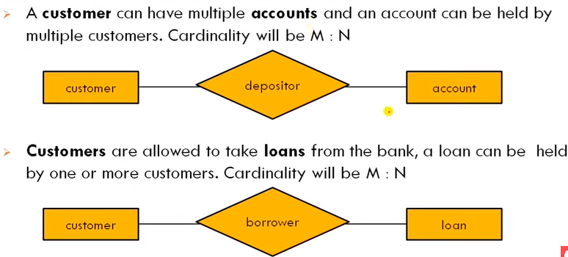
Identifying Relationships and participation constraints

Slide 10
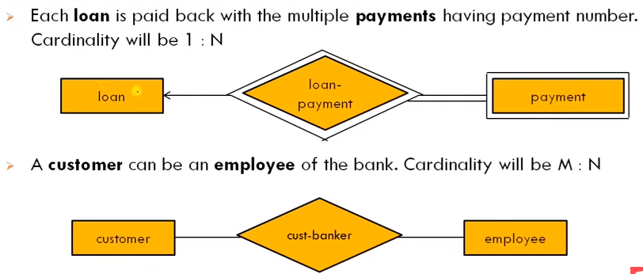
Identifying Relationships and participation constraints

Slide 11
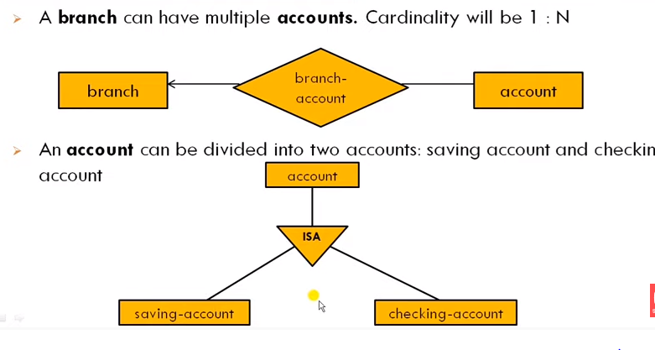
Identifying Relationships and participation constraints

Slide 12
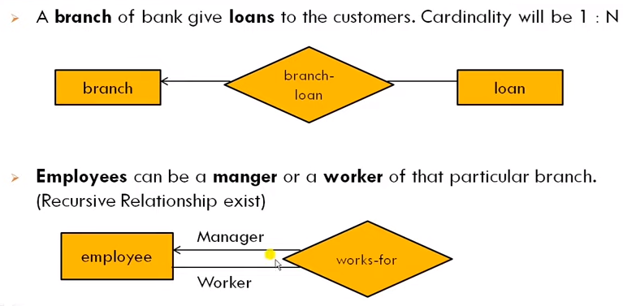
Identifying Relationships and participation constraints

Slide 13
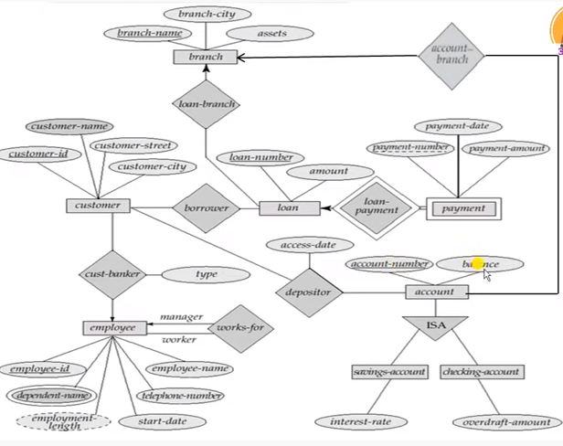
ER-D for bank database

Slide 14
In class Exercise ERD
Problem-1: International Courier Service, ICS, provides up-to-date information on the processing and current location of each shipped item. To do this, ICS relies on a company-wide information system in which shipped items are characterized by unique item number, weight, dimensions, insurance, destination, and final delivery date. Shipped items are received into the ICS system at a retail centre. Retail centres are characterized by their type, uniqueID, and address. Shipped items make their way to destination via one or more standard ICS transportation events (i.e., flights, truck deliveries). These transportation events are characterized by a unique scheduleNumber, a type (e.g, flight, truck), and a deliveryRoute. A transportation event may be carrying various shipped item. Create an Entity Relationship diagram that captures this information about the ICS system.

Slide 15
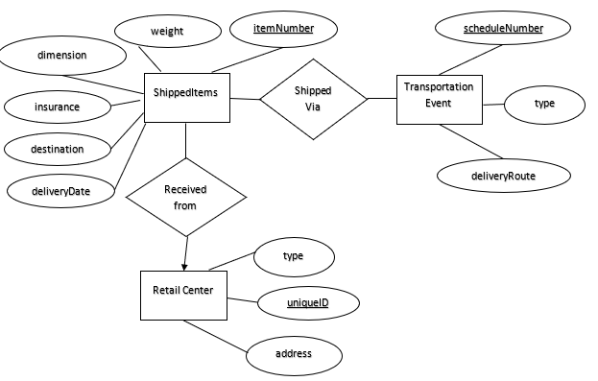
In class Exercise ERD

Slide 16
Problem-2: University database
We have students; each student has a unique ID, name, address, gender, major, and contact no. A student can have multiple contact numbers.
We have courses, each course has a unique courseID, title, and number of credits
Students will register in courses in certain semesters. Each semester has a unique ID, type (Fall, Spring, Summer) and a year associated with it. We need to keep track of the grade that a student has received in a given course. The model should allow a student to take the same course in different semesters.

Slide 17
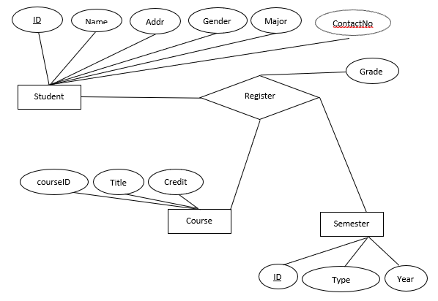
ERD

Slide 18
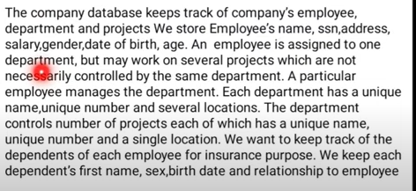
Example 3

Slide 19
